Slide 1
Face Detection Attendance System in Java
Step-by-step guide from setup to final application

Slide 2
Introduction
In this project, we will build a Face Detection Attendance System using Java.
We will use IntelliJ IDEA, OpenCV, and JavaFX/Swing for GUI.
The system will detect faces and store attendance records.

Slide 3


Tools & Technologies Required
- IntelliJ IDEA (IDE)
- Java Development Kit (JDK)
- OpenCV for Java
- JavaFX or Swing
- MySQL/SQLite (Database)
- Webcam

Slide 4
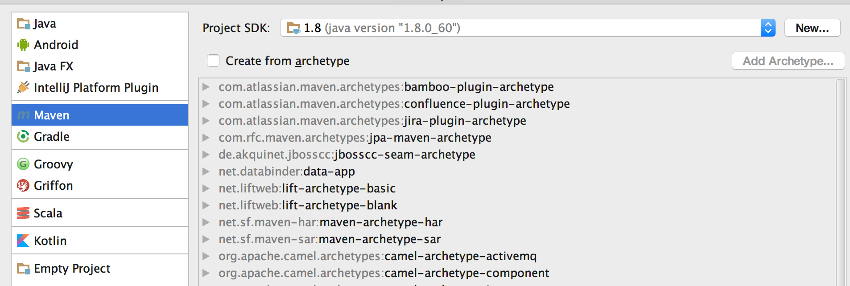
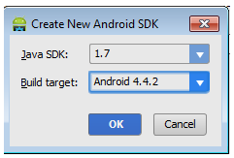
Step 1: Setting up IntelliJ IDEA
1. Download and install IntelliJ IDEA.
2. Configure the Java SDK.
3. Create a new Java project.

Slide 5
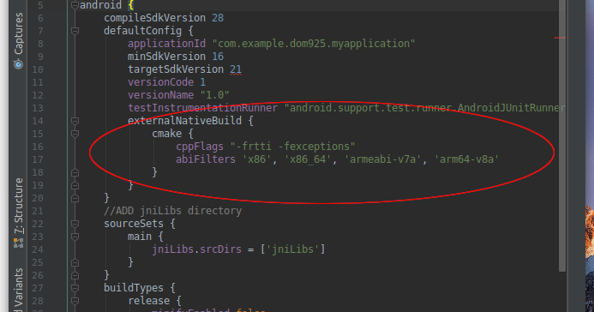
Step 2: Installing OpenCV for Java
1. Download OpenCV from the official website.
2. Extract files and add .jar to project libraries.
3. Configure native DLLs in VM options.

Slide 6
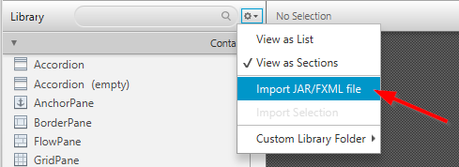

Step 3: Adding JavaFX or Swing
1. Decide between JavaFX (modern UI) or Swing (simpler UI).
2. Add JavaFX libraries if chosen.
3. Set up a basic GUI window.

Slide 7
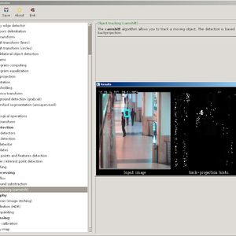
Step 4: Capturing Webcam Input
1. Use OpenCV's VideoCapture class.
2. Capture frames from the webcam.
3. Display live video in the GUI.

Slide 8
Step 5: Face Detection with Haar Cascades
1. Load Haar cascade XML file for face detection.
2. Apply face detection on each frame.
3. Highlight detected faces with rectangles.

Slide 9
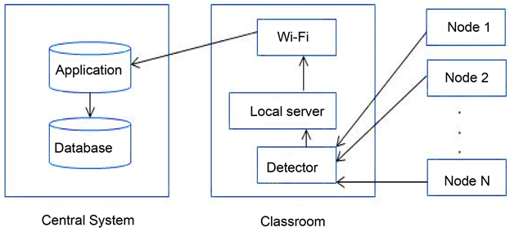
Step 6: Attendance Storage Options
We can store attendance in:
- CSV file (simple, lightweight)
- MySQL database (scalable)
- SQLite database (portable)

Slide 10
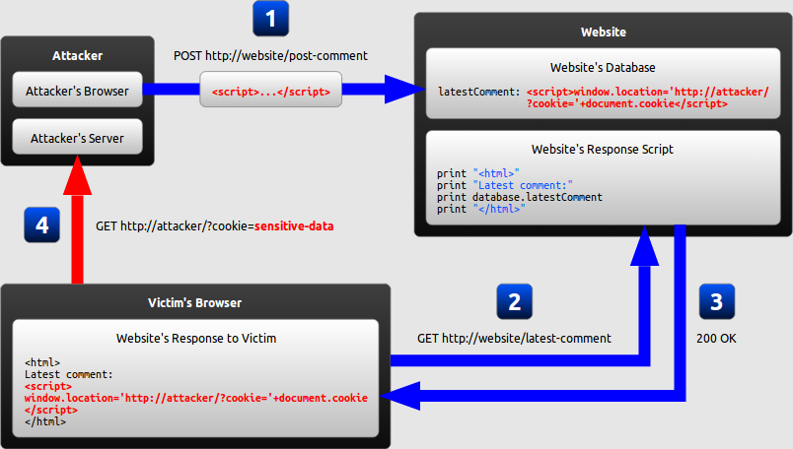
Step 7: Storing Attendance Data
1. When a face is detected, capture name and timestamp.
2. Append to CSV file OR insert into database.
3. Ensure duplicate entries are avoided.

Slide 11
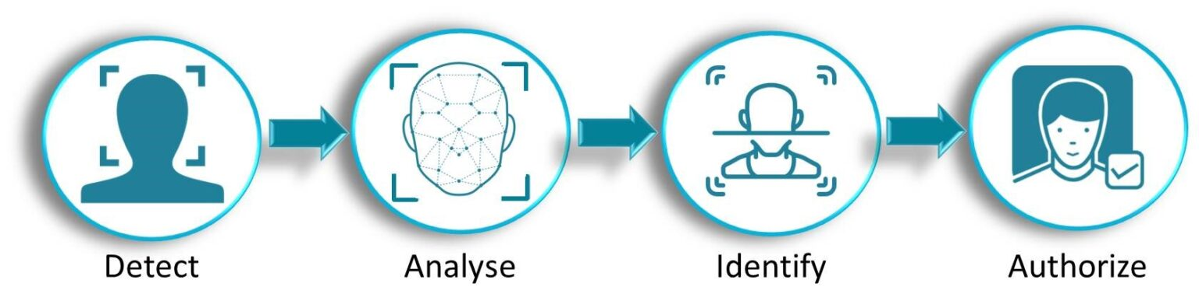
Step 8: Building the Complete Application
1. Integrate webcam feed, face detection, and attendance storage.
2. Create GUI with buttons like Start, Stop, Save.
3. Display attendance records in a table.

Slide 12
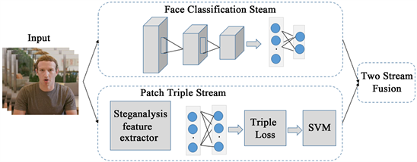
Step 9: Testing the System
1. Run the application.
2. Verify face detection accuracy.
3. Check if attendance data is correctly stored.
4. Handle errors like camera not found or database issues.

Slide 13
Conclusion
We have successfully built a Face Detection Attendance System in Java.
This project introduced:
- Java GUI (Swing/JavaFX)
- OpenCV integration
- Face detection with Haar cascades
- Attendance storage in CSV/Database
This can be extended with advanced features like face recognition.

